Slide 1
Division of Strategic Communications Update

Slide 2
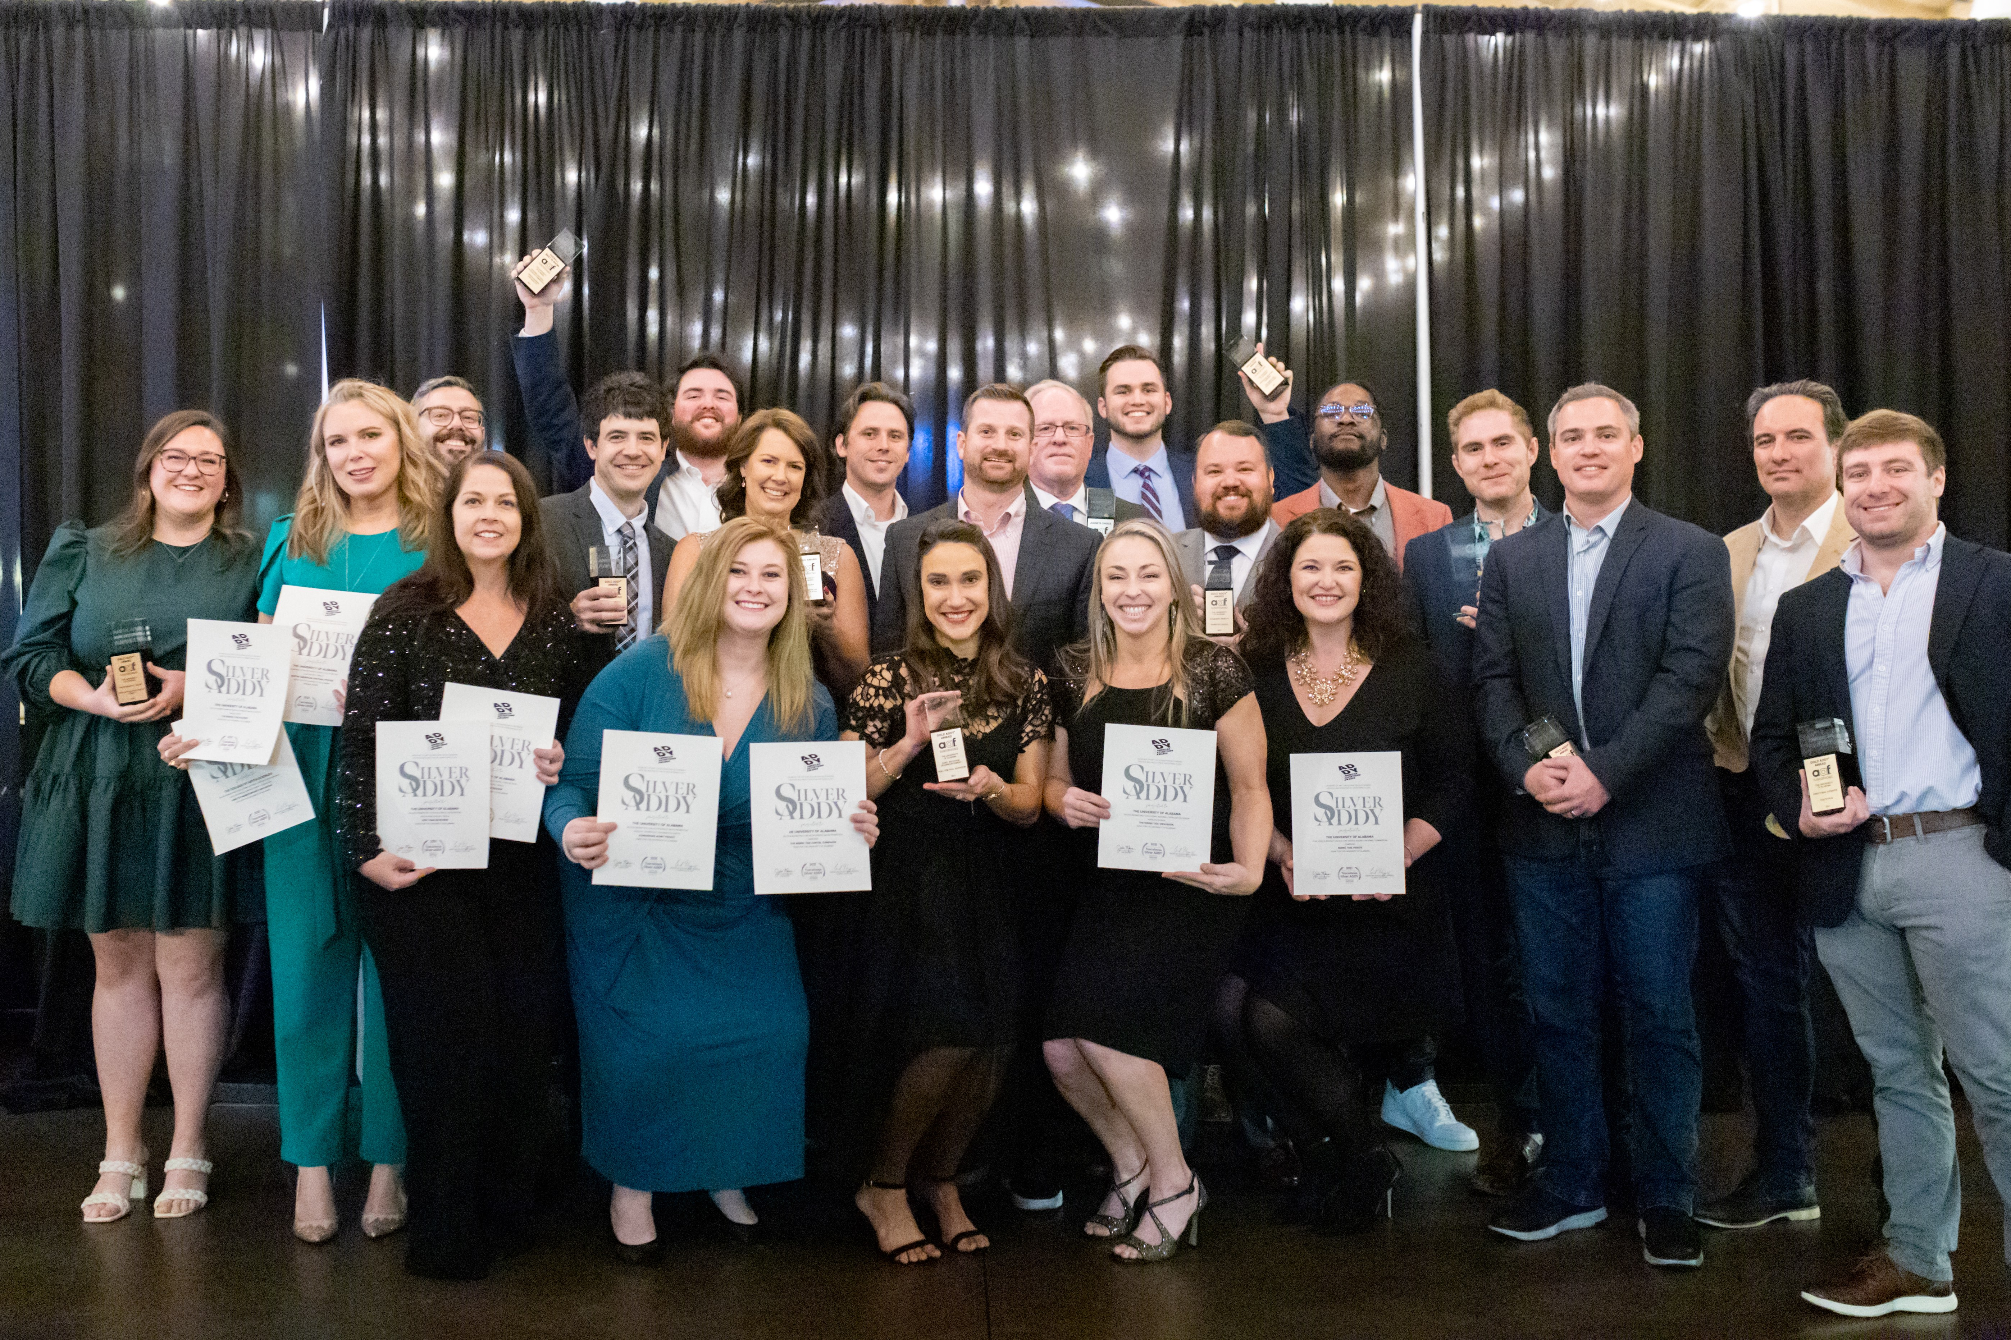
Strategic Communications Our Mission
We exist to tell The University of Alabama’s story in authentic, dynamic and strategic ways.

Slide 3
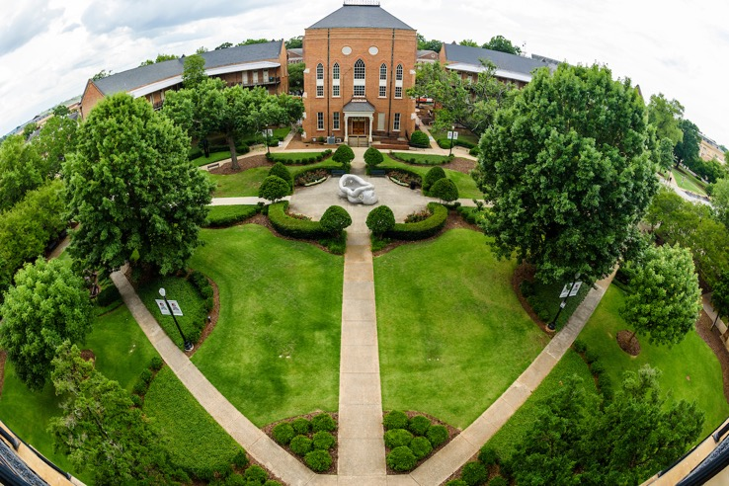
Strategic Communications About Us
Areas:
Communications
Marketing and Brand Strategy

Slide 4
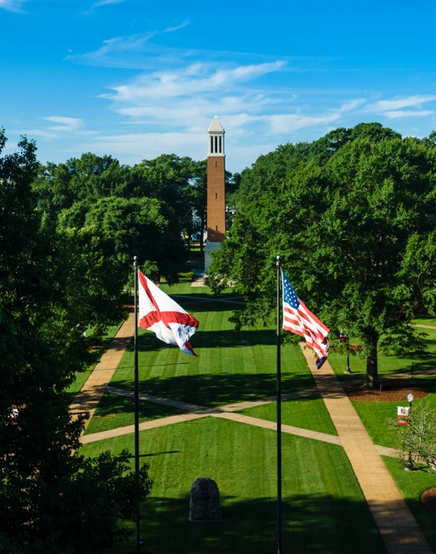
Strategic Communications About Us
Communications
Internal Communications
Faculty/Staff
Students
Parents & Families
External Communications
Media
Alumni & Donors
Prospective Students & Families
General Public
Crisis Communications
Web Strategy
Presidential Communications
Open Records

Slide 5
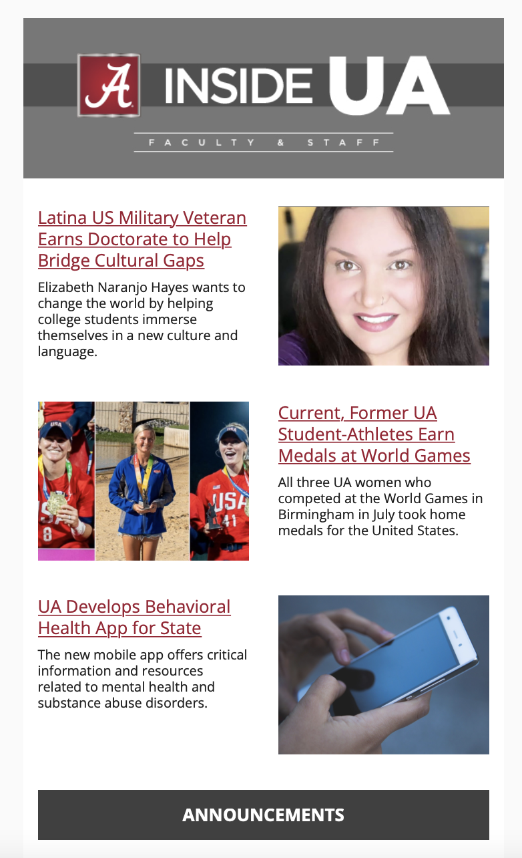
Strategic Communications About Us
Communications:
Inside UA newsletters
NEWS.ua.edu
Merit – student news
92.5 UA Info Radio
On-hold messaging
UA Alerts
UA Safety App
Research Magazine
Year in Review
Notes:
Crisis communications, research communications,
Internal – Inside UA newsletter

Slide 6
Strategic Communications About Us
Marketing &
Brand Strategy
Marketing
Design & Production
Photography
Video
Social Media
Brand Strategy
Ceremonies & Events (commencement)

Slide 7
Strategic Communications
Key Partners
Admissions (Student Recruitment)
Undergraduate Admissions
Graduate School
UA Online
Advancement
Academic Affairs
Student Life
President’s Office
UA System Office

Slide 8
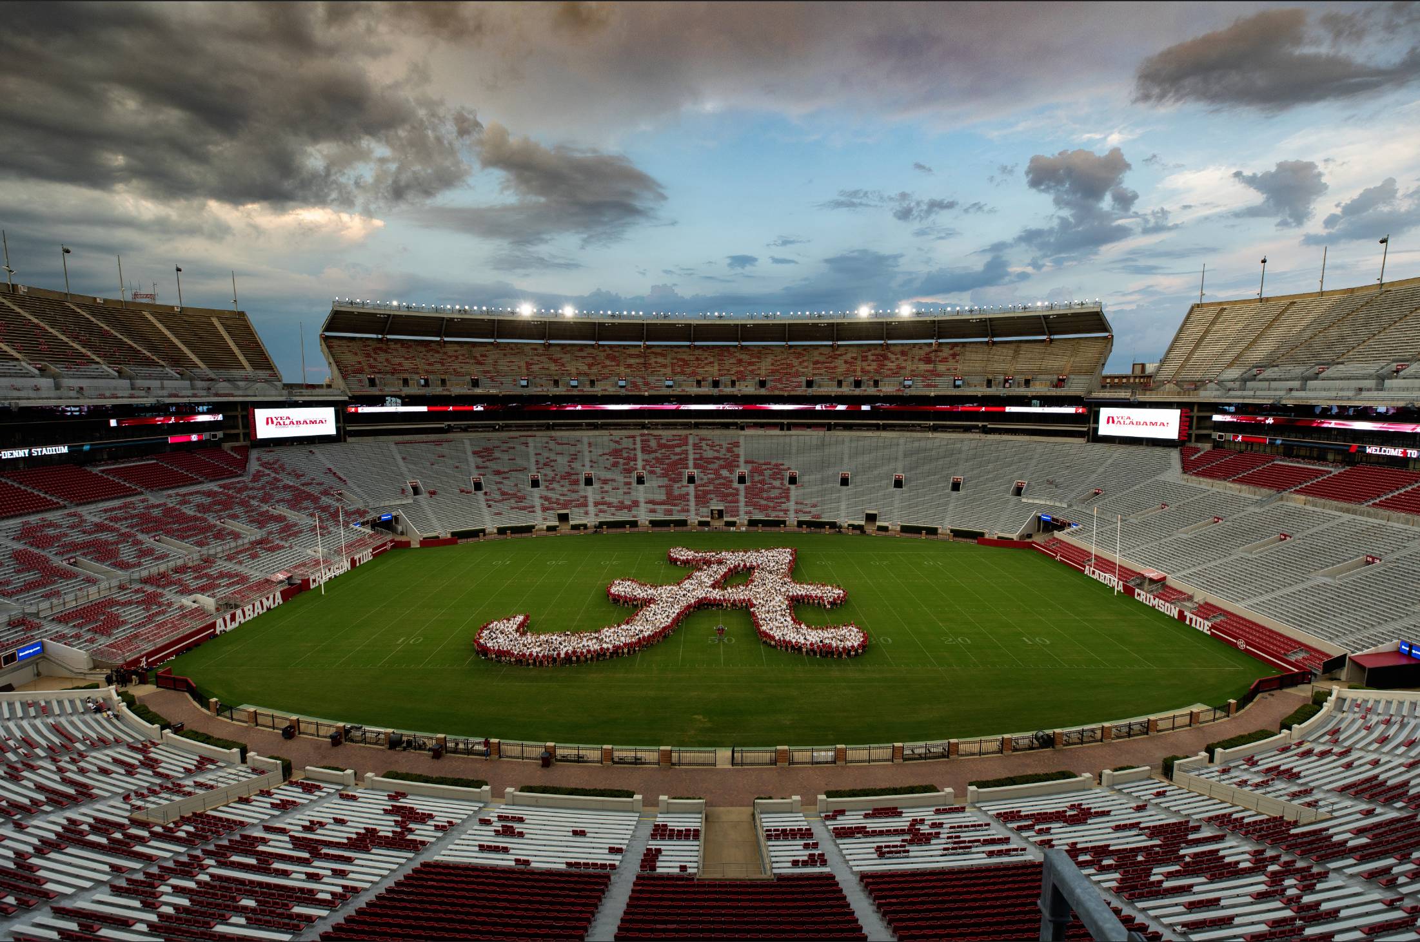
Strategic Communications
Other Partners
Athletics
Research
Alumni
Community Affairs
Legal
Finance & Operations
DEI
Faculty Senate
SGA

Slide 9
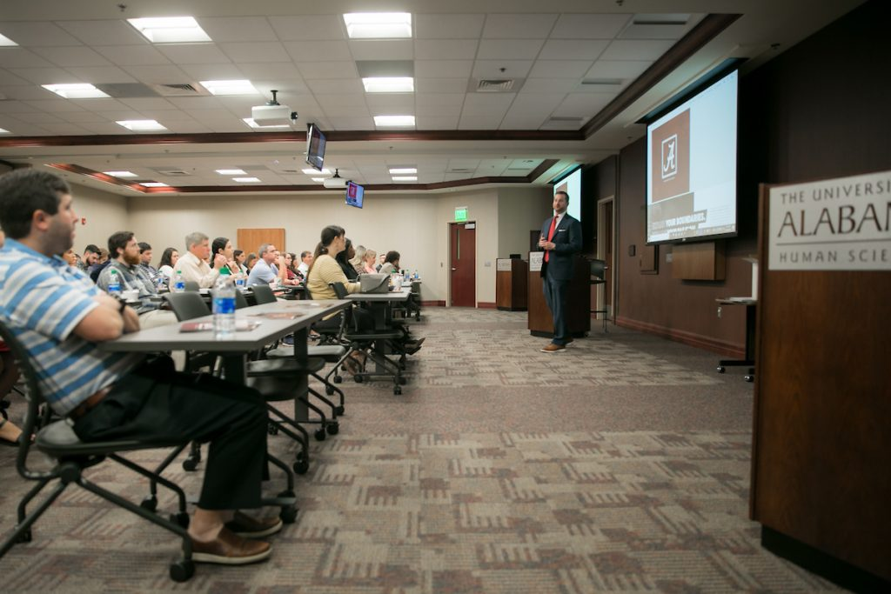
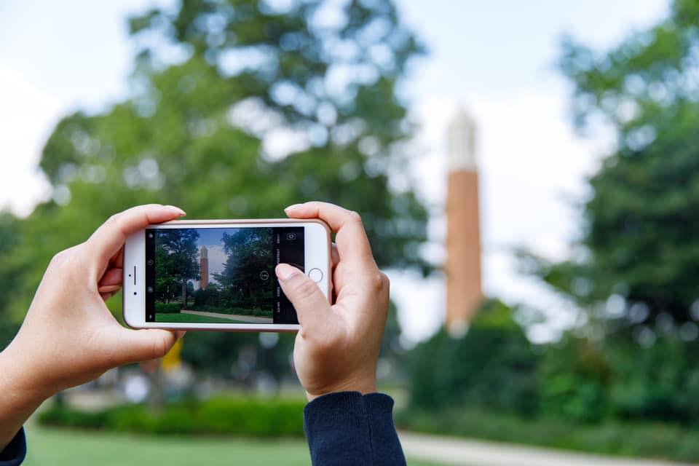
Strategic Communications Campus Collaboration Networks
Campus Communicators
Trending Tide – Social Media
Web Developers

Slide 10
Strategic Communications University Branding

Slide 11
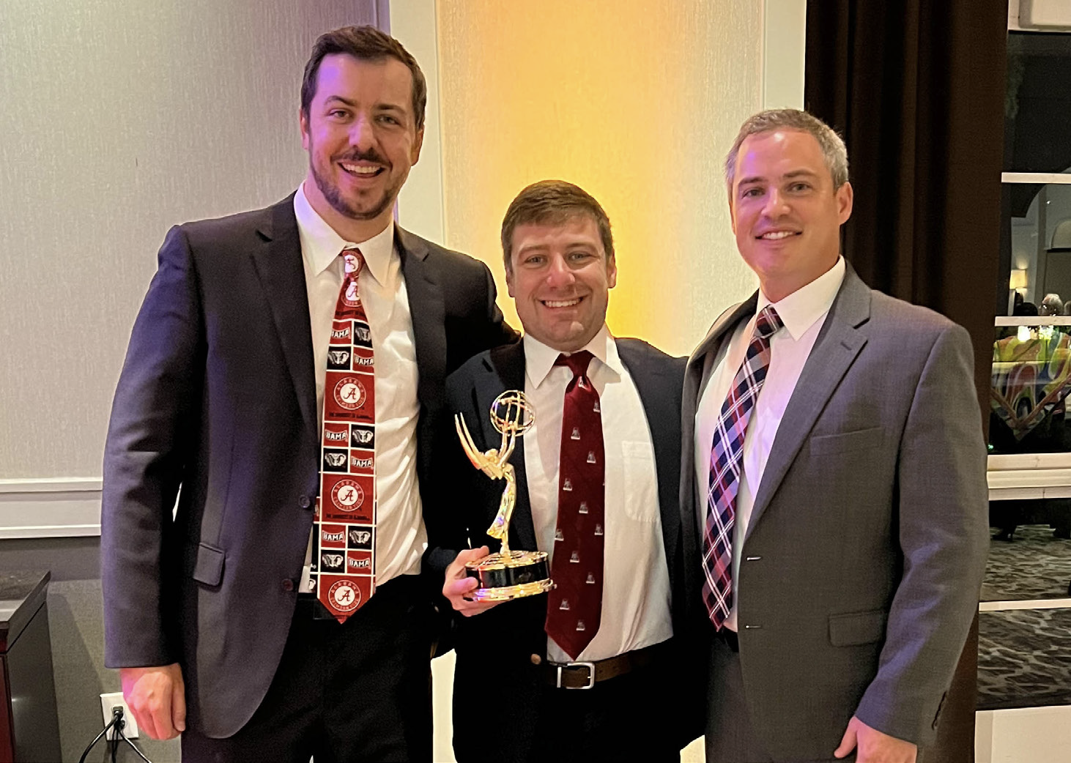
Strategic Communications Recent Accomplishments
31 Industry Awards
18 AAF
1 Emmy
4 PRCA
5 Telly
3 CASE Circle of Excellence

Slide 12
Strategic Communications Online Resources
Stratcomm.ua.edu
Branding
Directories
Request Forms
Policies & Guidelines

Slide 13
Strategic Communications Web Governance
Web Policy
Emphasis on public-facing informational & representative websites
“Official sites” – represent a University academic or business unit
“Unofficial sites” – do not represent an official unit (ex: faculty personal pages)
Handoff to guidelines for technical specifics

Slide 14
Strategic Communications Web Governance
Web Policy
Web Branding Guidelines
Web Developer Guidelines

Slide 15
Strategic Communications Web Developers Network
Developers across campus collaborate on University web framework
15 active members from ~10 units
Similar to an open-source community
Expanding mission to include content professionals
Web Forum
Open agenda meetings conducted quarterly
Open to all members of the campus community
Agenda items submitted via email to web@ua.edu

Slide 16
Strategic Communications Web Resources for Faculty & Staff
Your college/division’s communicators
UA Wordpress Themes
CIT
Web Branding Guidelines
Web Forum
Webtide

Slide 17
stratcomm.ua.edu

