Slide 1
CYBERSECURITY
UPDATES
Taylor B. Anderson, Chief Information Security Officer

Slide 2
LastPass Breach Response
Most LastPass customers at risk
The user’s master password and strength of LastPass' algorithm is all that stands in the way of bad actors
URLs were exposed, which increases the likelihood of more targeted phishing attempts
Following OIT Security guidance from the announcement will substantially lower the risk to UA and our users

Slide 3
TikTok
It’s impractical to attempt to block TikTok
Some courses utilize TikTok

Slide 4
A Few Definitions…
Malware - software that is designed to disrupt, damage, or gain unauthorized access to a computer system (viruses, worms, trojans, ransomware, etc.)
Ransomware - a type of malware designed to block access to a computer system until a sum of money is paid
Phishing - sending emails purporting to be from reputable companies in order to induce individuals to download malicious software or reveal personal information, such as passwords and credit card numbers (PII)

Slide 5
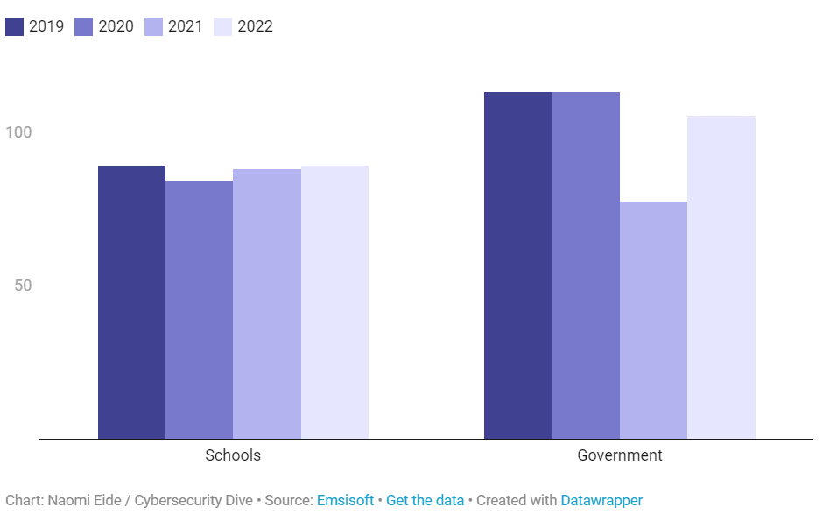
Ransomware – are we at risk?
Yes!
(Known) ransomware attacks against the education sector have remained steady since 2019
Notes:
Schools were hit steadily with ransomware attacks in 2022 (universitybusiness.com)
Ransomware hit US schools at steady rate in 2022 | Cybersecurity Dive

Slide 6
MAJOR EVENTS IN THE NEWS (2022)
Lincoln College
After 157 years of operation, forced to close due to a ransomware attack
University of California, SF
Stolen student records/data - $1.14m ransom paid
Austin Peay State University
Ransomware caused 3-day outage and delay of final exams
Cincinnati State Technical and Community College
Increased defenses in other sectors have pushed malicious actors to higher ed
Notes:
According to the notice on the Lincoln College website, “All systems required for recruitment, retention, and fundraising efforts were inoperable. Fortunately, no personal identifying information was exposed. Once fully restored in March 2022, the projections displayed significant enrollment shortfalls, requiring a transformational donation or partnership to sustain Lincoln College beyond the current semester.”

Slide 7
MFA Deployment
Now working on future state
Passwordless or device-based authentication where possible
Substantial amount of clean-up before this can be done

Slide 8
Phishing Simulation
Already seeing repeat offenders – will target with more direct training
Building additional training for those who are victim to real phishing emails

Slide 9
End of Life Operating Systems
Operating System | EOL Date
Windows XP | April 2014
Windows 7 | January 2020
Windows 8.1 | January 2023
Windows Server 2003 | January 2015
Windows Server 2008 R2 | January 2020
Windows Server 2012 | October 10, 2023
Mac OS 10.15 or older | November 2022
Many version of Linux… | security@ua.edu if concerned
Notes:
Microsoft Windows | endoflife.date

Slide 10
End of Life Operating Systems
These are a huge risk because they are no longer being patched. If vulnerabilities are found, they aren’t fixed.
Options:
Remove from network
Isolation

