Slide 1
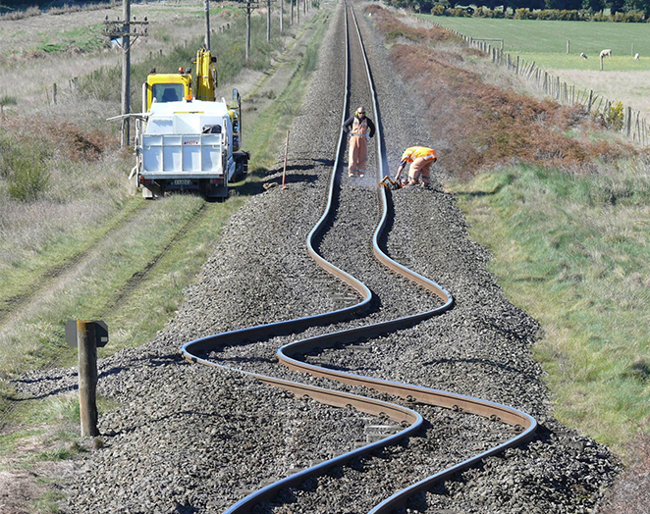
2/6/2023 Turkiye Earthquakes and Relief Efforts
Dr. Mesut Yavuz

Slide 2
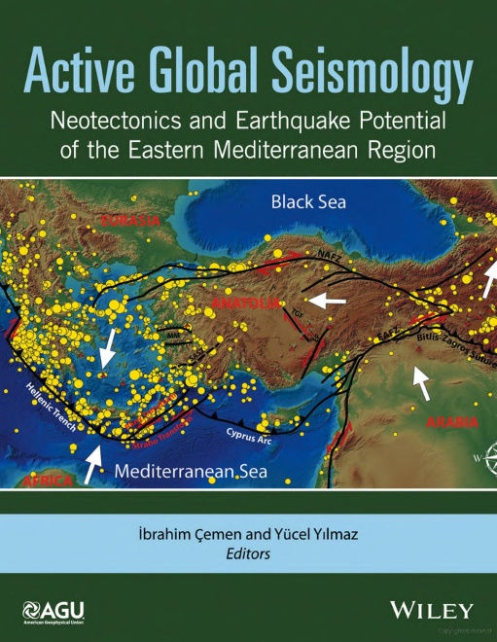
Earthquakes are a fact of life in the Eastern Mediterranean Region

Slide 3
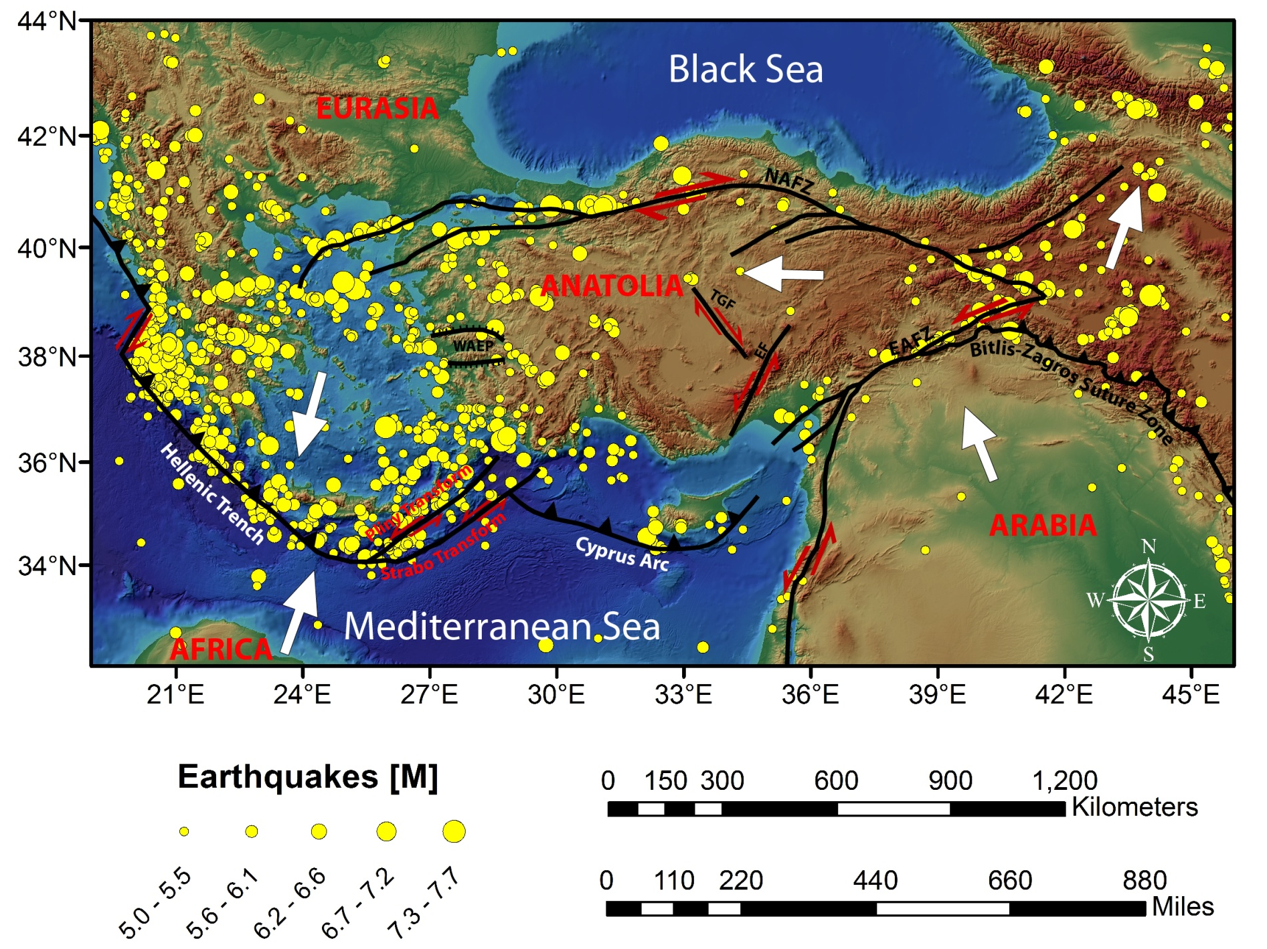
Earthquakes of the Eastern Mediterranean Region between 1900-1999
Çemen and Yilmaz, 2017

Slide 4
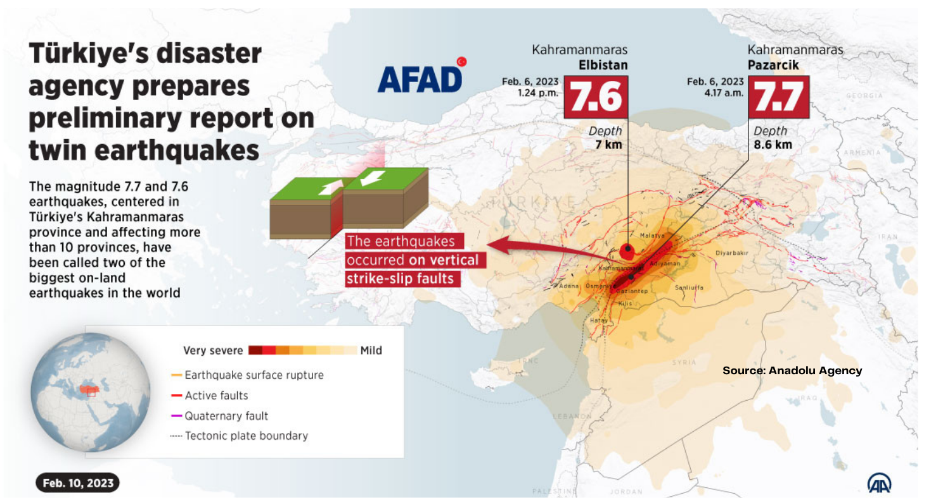
The Earthquakes of February 6, 2023
There have been only 3 earthquakes in the continental US since 1950 of comparable magnitudes*:
1952 California 7.7
1959 Montana 7.7
1992 California 7.6
* Data from https://www.ngdc.noaa.gov/hazel/view/hazards/earthquake/event-data

Slide 5
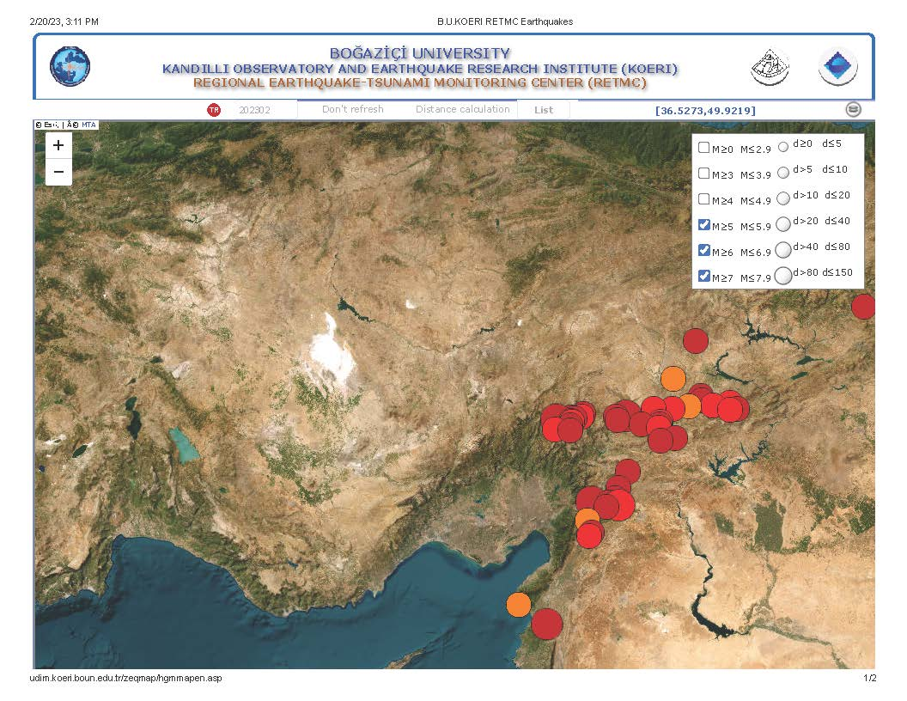
Earthquakes over Mw=5.0 since February 6, 2023

Slide 6
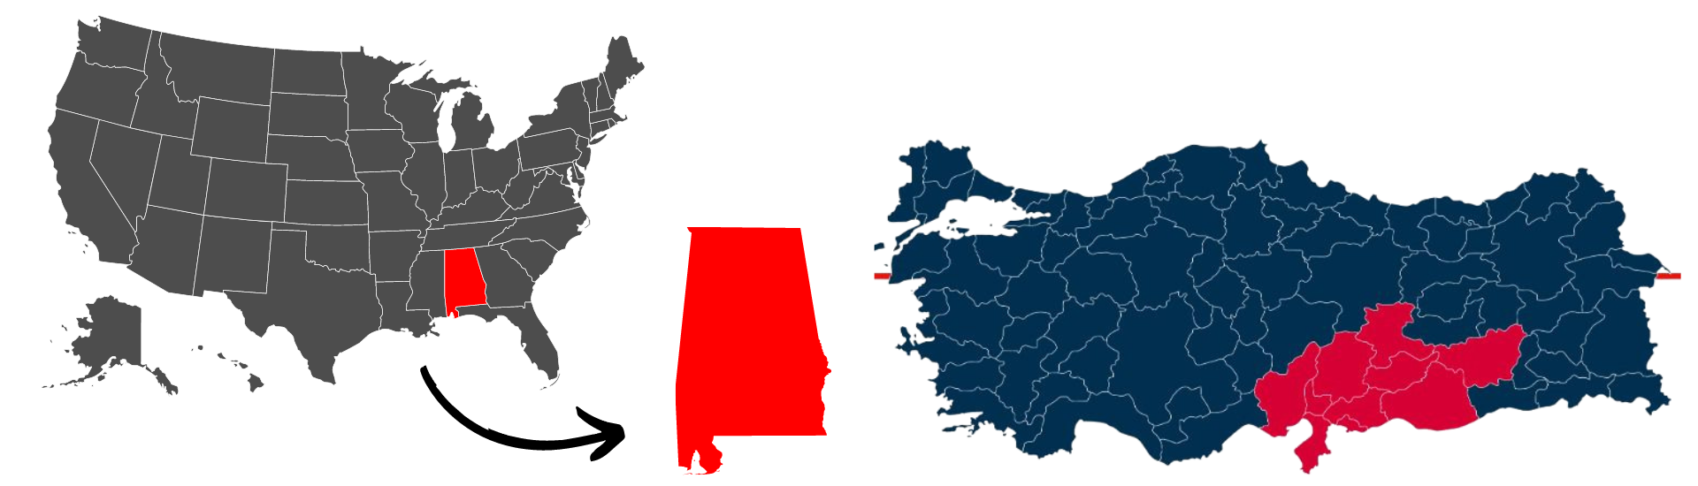
How widespread is the issue?
10/81 Turkish provinces were impacted
  Land area: ~38K mi² & Population: ~13M
To put things in perspective
  In Alabama, ~5M people live on ~52K mi²
  The ares affected are roughly twice as big as the country of Switzerland

Slide 7
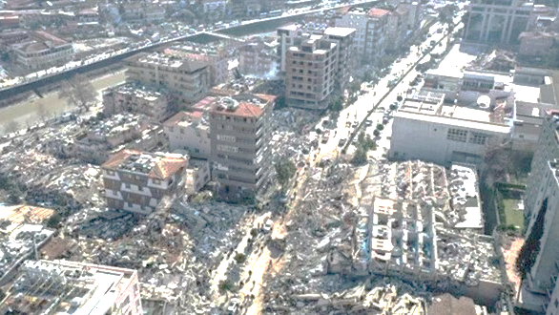
How many people were affected
Of the 13.3 million people
  41,156 dead (as of 2/20)
  105,505 injured
  Relocations
    865,000 in tents
    23,500 in container homes
    376,000 relocated to other provinces and placed into dorms
    Many more fled the region on their own
Buildings
  5,775 collapsed
  458K to be demolished

Slide 8
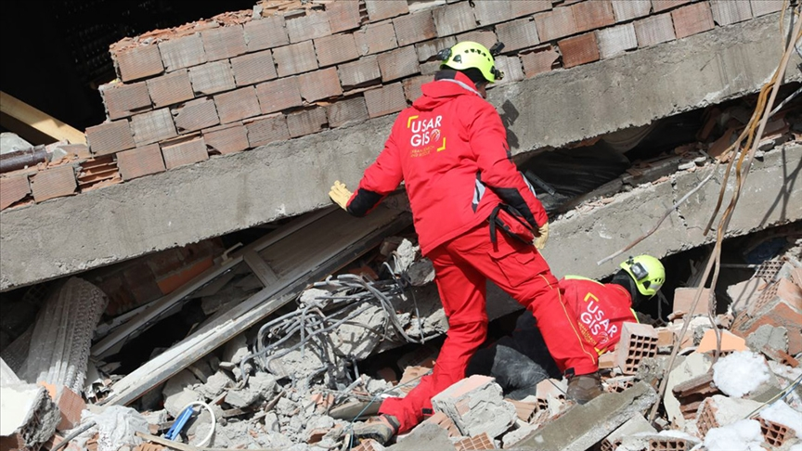
Search & rescue
>250K staff at work
>9K foreign rescuers from near 100 countries
A family of 3 was rescued in the 296th hour (13th day)

Slide 9
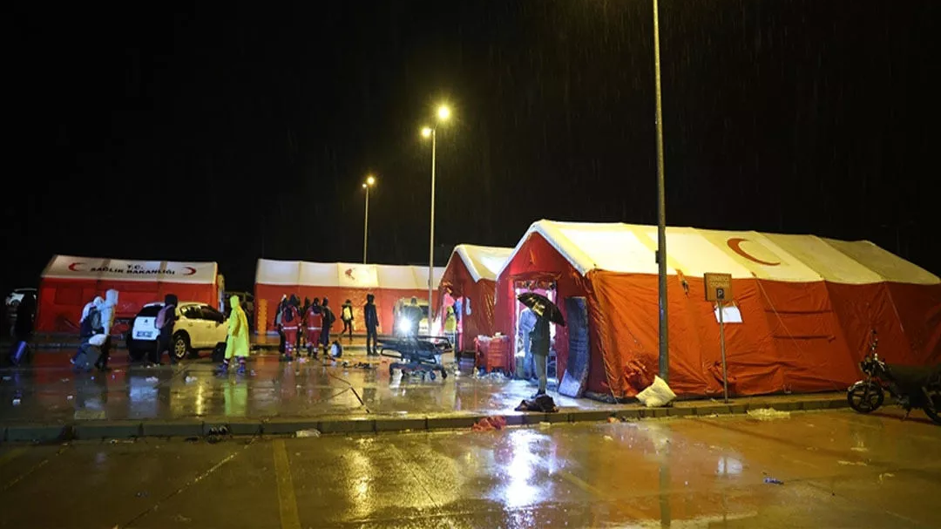
Field Hospitals
77 field hospitals in use throughout the 10 provinces
18K doctors
144K total personnel

Slide 10
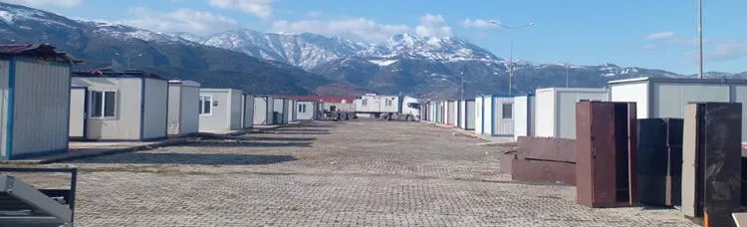
Temporary Housing
AFAD alone put up 51K tents
Thousand of containers planned, some have already been shipped

Slide 11
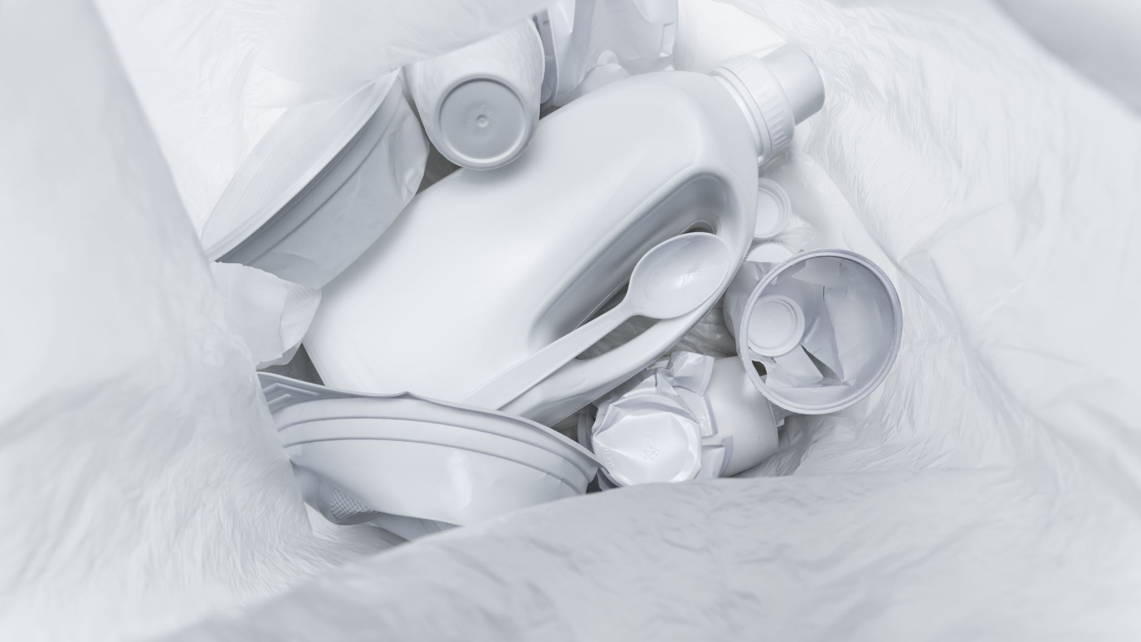
What else is being provided / is needed?
Food
Clothing
Heaters
Portable toilets
Personal hygiene products
. . .
Basically, anything and everything one needs to restart living

Slide 12
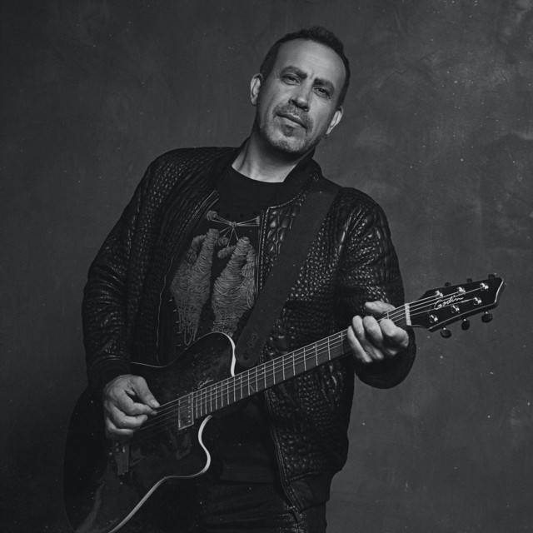
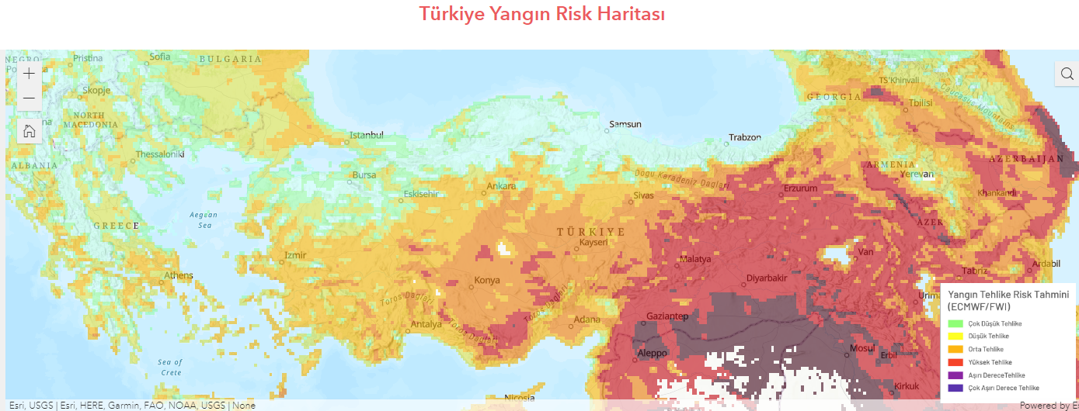
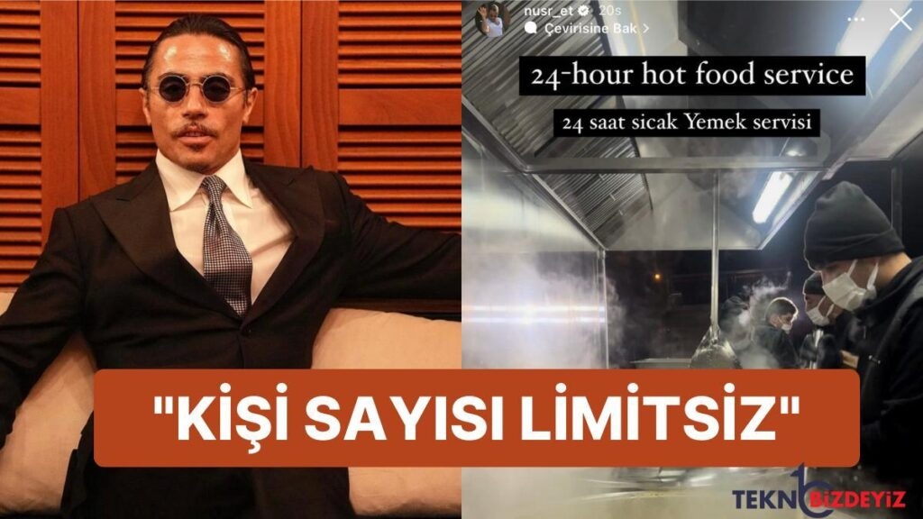
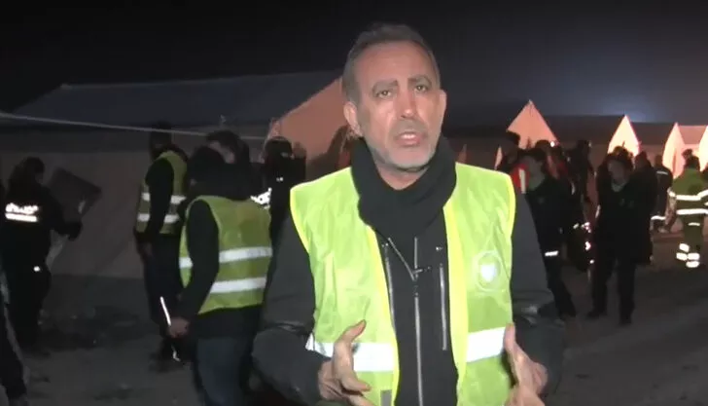
Volunteers, donors and campaigns
Haluk Levent & Ahbap
Mert Firat & the map of needs
Salt Bae
Professional sports teams & The media
Caffè Sospeso → suspended rent

Slide 13
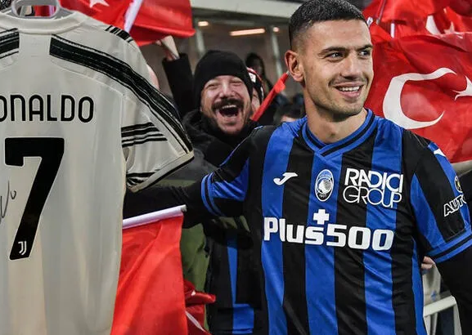
Foreign Donations
Countries
  US: $19M
Organizations
  Companies
  Charities
  Sports leagues
    €25M from the Netherlands
Individuals
  Merih Demiral raised 7.5M Liras

Slide 14
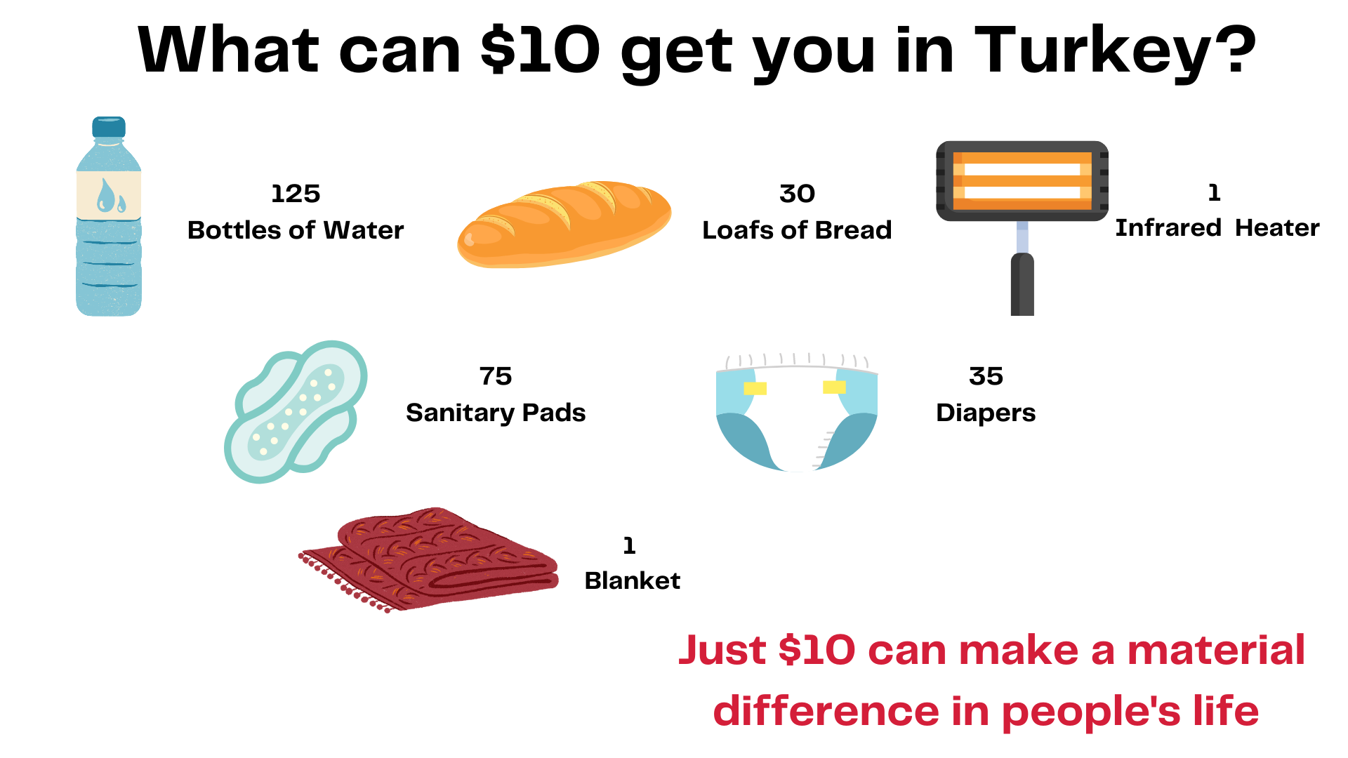
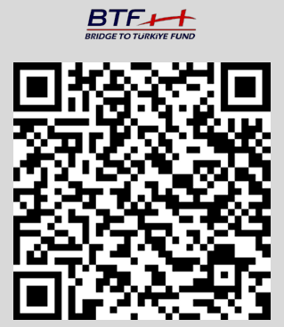
Every $ counts
Donate
  Both short- and medium-term
Bridge to Turkiye fund
  Partnering with Haluk Levent’s Ahbap in the short term
lives

Slide 15
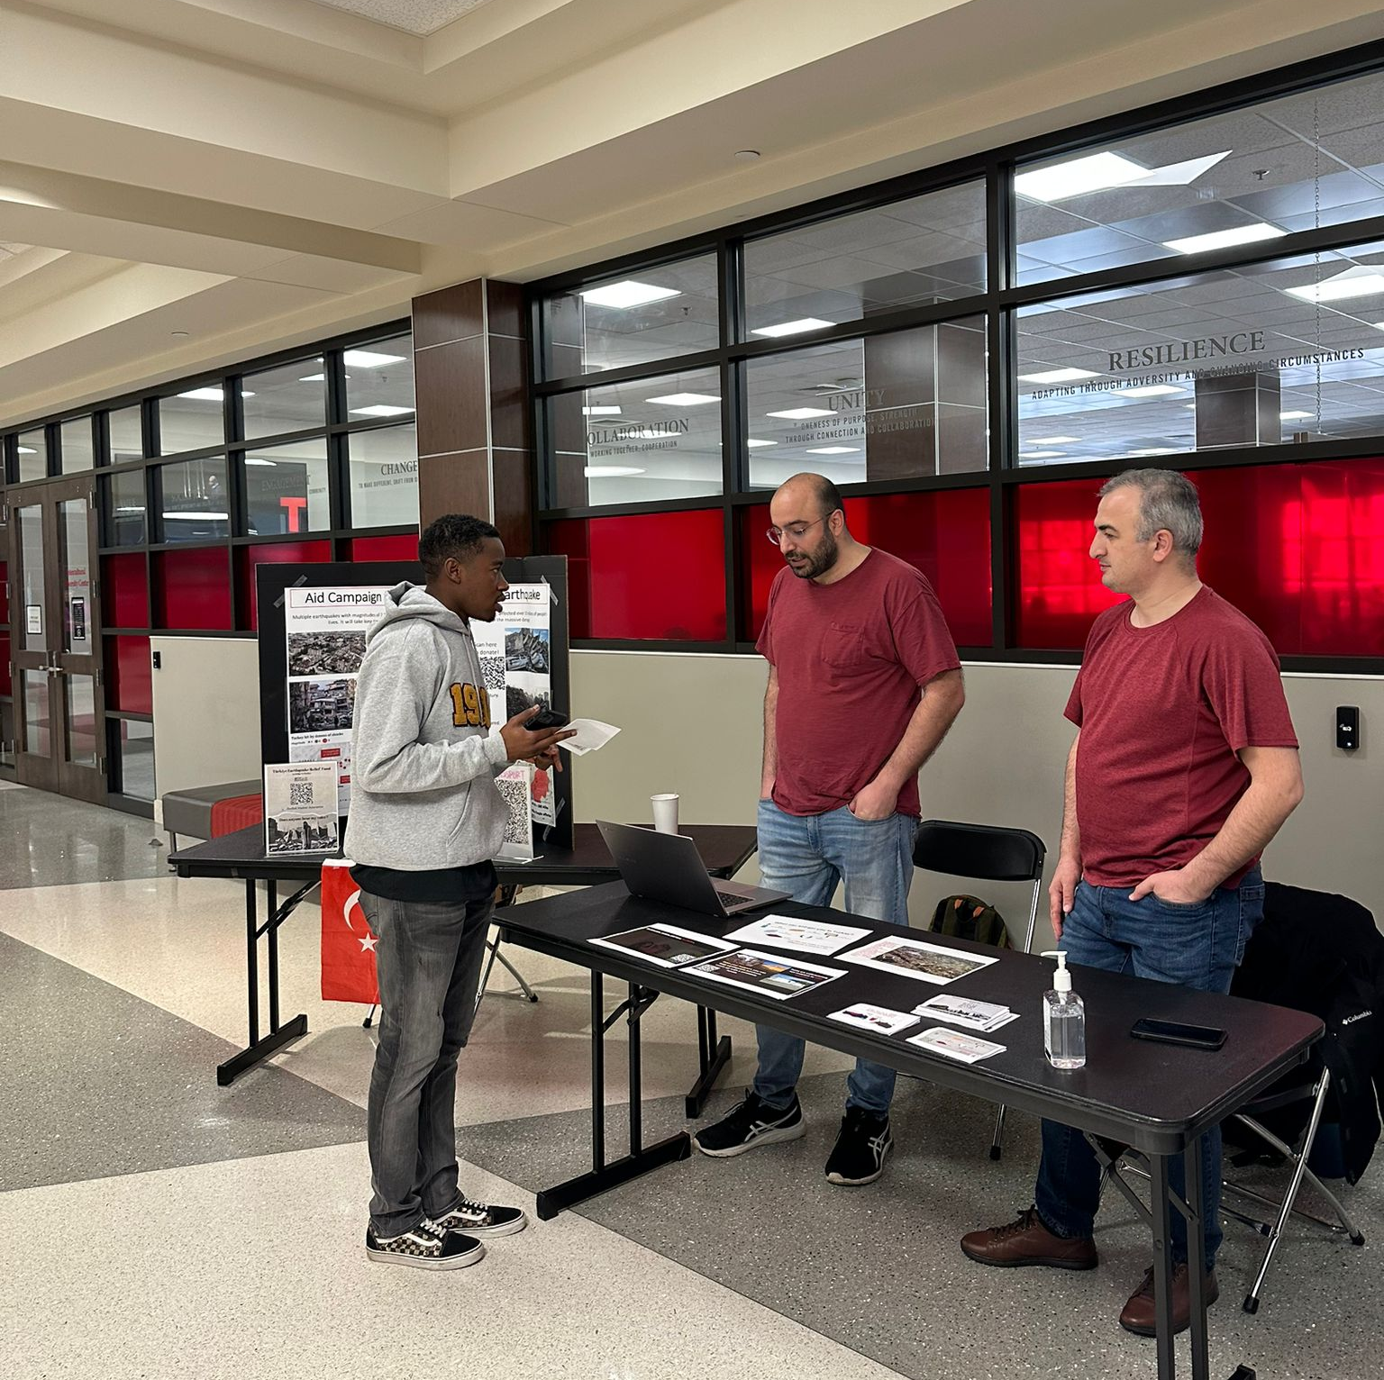
What’s been done at UA
Turkish Student Association (TSA) set up an information desk at the Student Center
An event has been planned for 2/28/23 @ Gorgas Library
  6:00-7:30PM, Yellowhammer Room
Dr. Ibrahim Çemen (of the Department of Geological Sciences) and others have given interviews and appeared on local TV news
  An example: https://www.wvua23.com/alabama-students-raise-money-for-turkey-earthquake-relief/

